Slide 1
Customer Lifetime Value

Slide 2
OBJECTIVE
The lifetime value of a customer, or customer lifetime value (CLV), represents the total amount of money a customer is expected to spend in business, or on products, during their lifetime. This is an important figure to know because it helps company to make decisions about how much money to invest in acquiring new customers and retaining existing ones.

Slide 3
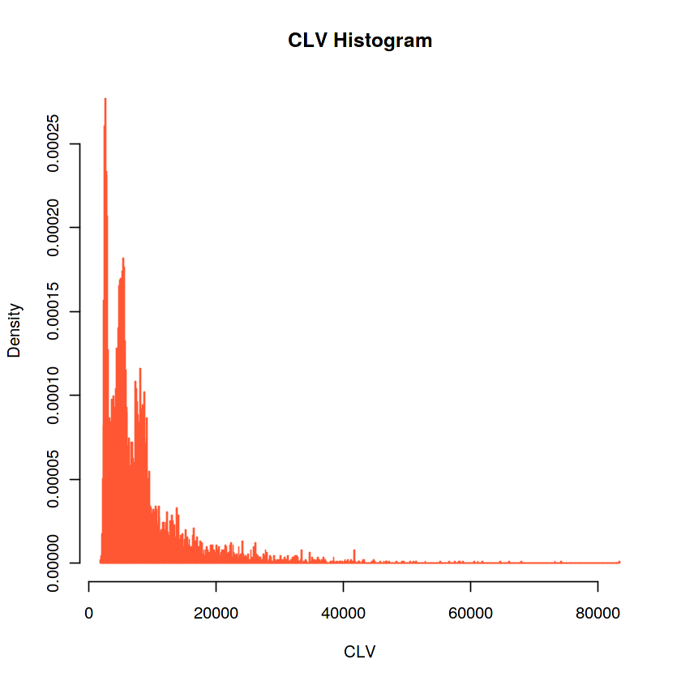
DEPENDENT VARIABLE
Customer lifetime Value is the dependent or target variable in this analysis.
Graphical
representations:

Slide 4
Count of variables and observations:
The analysis contains 23 number of variables and 9134 number of observations.

Slide 5
SIGNIFICANT VARIABLES
Monthly Premium Auto
Number of Open Complaints
Number of Policies
Total Claim Amount

Slide 6
INSIGNIFICANT VARIABLES
Customer, State, Response, Coverage, Education, Effective To Date, Employment Status, Gender, Income, Location Code, Marital Status, Months Since Last Claim, Months Since Policy Inception, Policy Type, Renew Offer Type, Sales Channel, Vehicle Class, Vehicle Size

Slide 7
Explanation of significant variables
The estimated regression line equation can be written as follow:
CLV = 486.82 + 82.22 MPA – 247.02 NoOC + 80.63 NoP - 0.665 TCA
p-value of Monthly Premium Auto (MPA), Number of Open Complaints (NoOC), Number of Policies (NoP) and Total Claim Amount (TCA) is less than 0.05 so they are significantly impact the CLV.

Slide 8
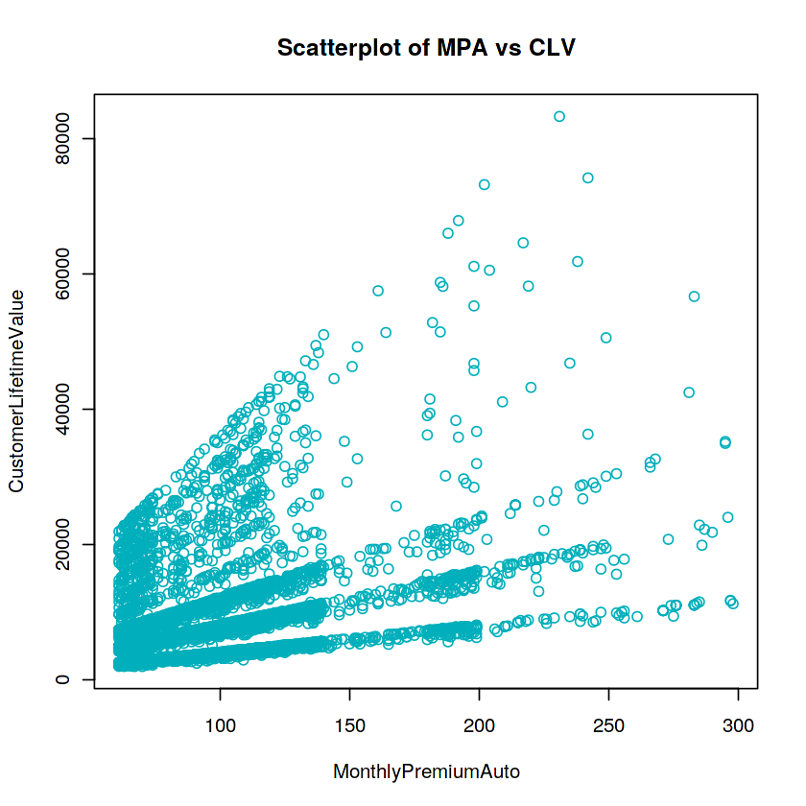
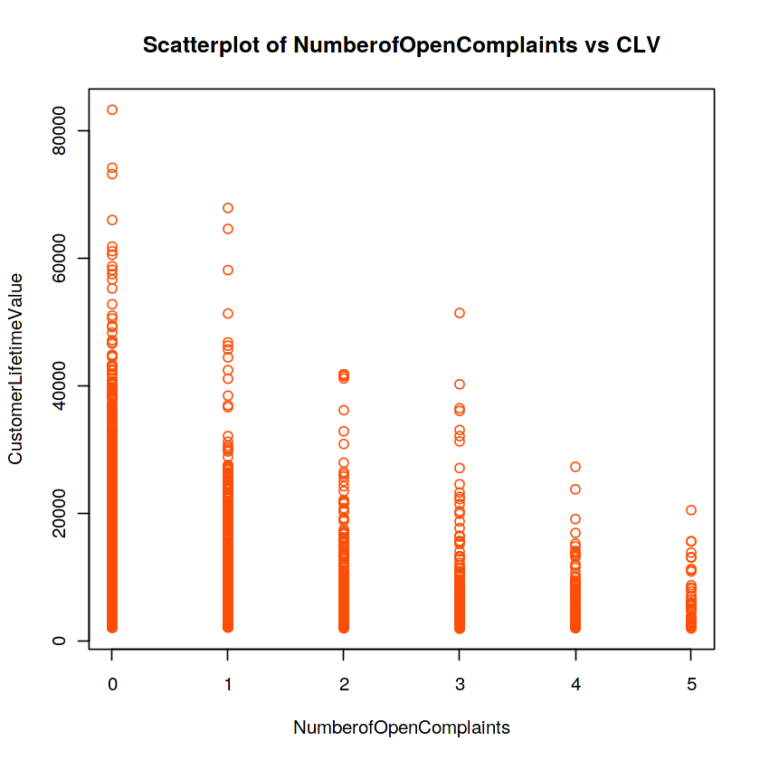
Graphical display of significant variables

Slide 9
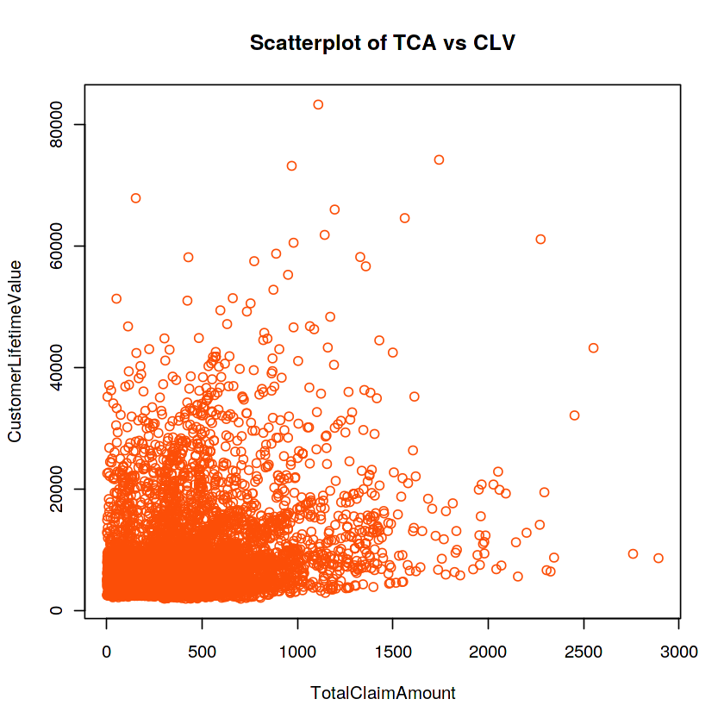
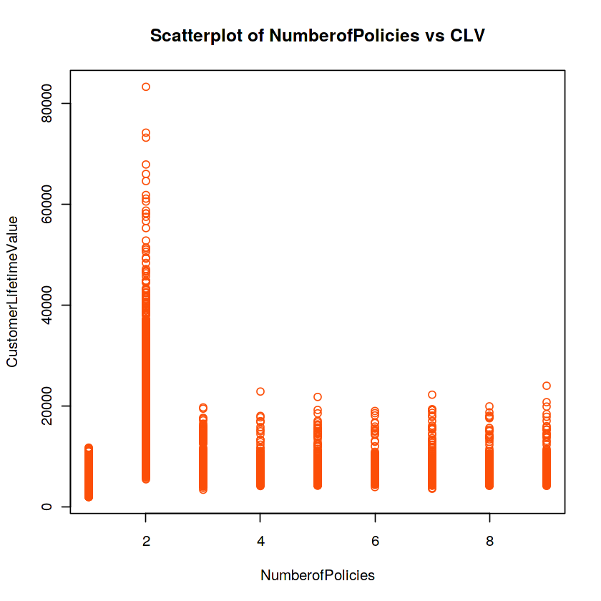

Slide 10
RESULTS OBTAINED
1. Detecting multicollinearity
In our model, only those independent variable should exist which are not correlated with each other. This is done using Correlation Matrix.
Variance inflation factor (VIF) is a measure of the amount of multicollinearity in a set of multiple regression variables.
If there is high correlation between two independed variables (high multicollinearity), then you will not be able to seperate out the impact of individual independed variable on depended variable.
Due to multicolinearity we can't define the complete impact of only one independed variable on the depended variable.
MonthlyPremiumAuto
1.67728411765984
NumberofOpenComplaints
1.00023669427589
NumberofPolicies
1.0002991479061
TotalClaimAmount
1.67692535683477

Slide 11
2. Detecting Homoscedasticity
Null Hypothesis - Homoscedasticity is present in Residuals.
Alternate hypothesis - Heteroskedasticity is present in residuals.
This is done by Breusch-Pagan test.
p-value < 0.05, so it rejects that errors are homoscedasticity. So errors terms are heteroscedasticity and does not have constant variance which is not good for model.
3. Detecting Autocorrelation
This is done Durbin-Watson Test If D-W Statistic is around 2, then we have autocorrelation in model. and away from 2 means no autocorrelation.
Here D-W Statistic is 2.01194, so there is autocorrelation in the model.
4. Detecting MAPE
MAPE computes the average absolute percent difference between two numeric vectors.
Average error rate of model is 60.43%, which is high and we can say that model is not so good.

Slide 12
Variable relationships:
Positive variables: CLV = 486.82 + 82.22 Monthly Premium Auto
+ 80.63 Number of Policies
Negative Variables: CLV = – 247.02 Number of Open Complaints - 0.665 Total Claim Amount

Slide 13
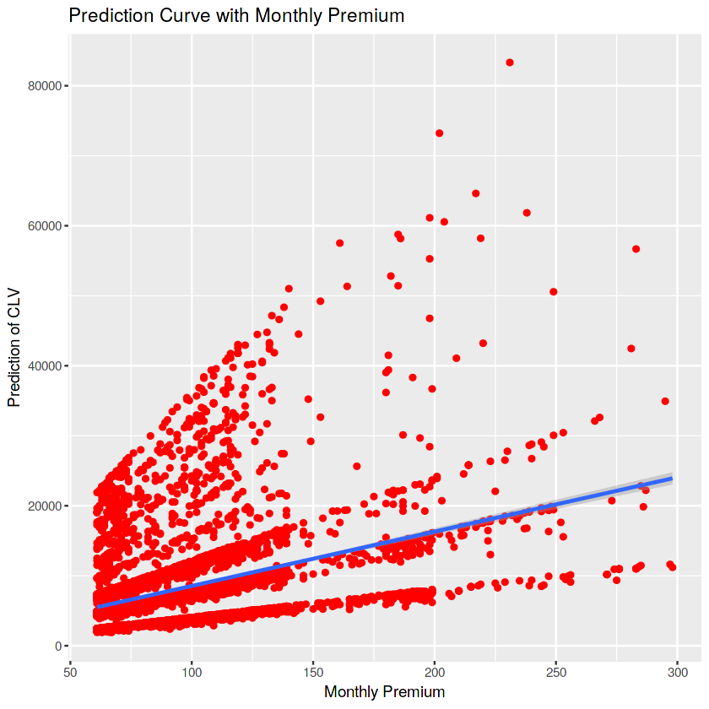
Prediction Curves :

Slide 14
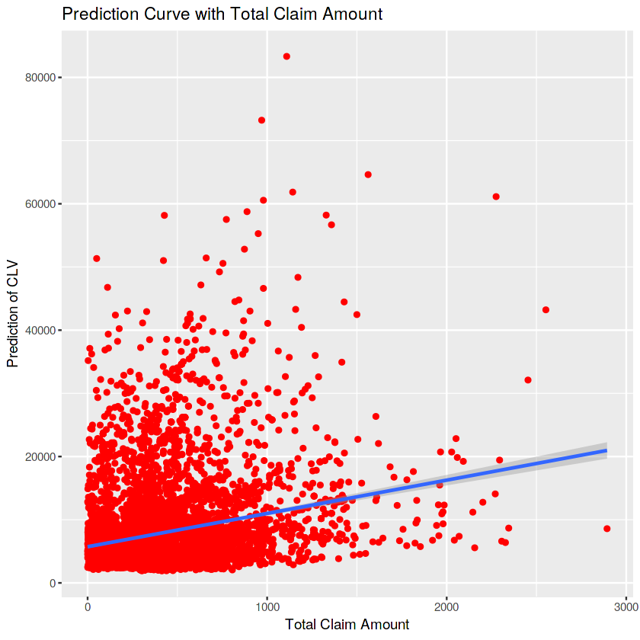

Slide 15
Summary
There are a lot of Customers with low CLV. Very few customers with high CLV.
Customers who have taken Basic Insurance for their vehicle are more valuable then Extended or Premium Insurance Policy holders.
Educated Employed customers (with a bachelors or equivalent degree) are more valuable than Retired, Unemployed or Disabled Customers.
Gender has no role to play in determining the value of a customer. Both Male and Female looks valuable.
Marital customers are buying more auto insurance and adding more value to company.
Rural customers are LESS valuable than Urban customers.
Customers having their own Personal Policy are more valuable to company then Corporate and Special Insurance policy holder.
Offers 1 and Offer 2 attracts more customers.

Slide 16
Call Center is not performing well compared to other channels throughout the country (in terms of high value customers)
10. Customers having Mid Size vehicles, Four-Door car or SUV are more valuable.
11. California customers are adding more value to the company.
12. Personal L3 Policy is adding more value to company.xiii.
13. The customers having more number of policies with high monthly premium will add more value to company. On the other hand, customer's Open Complaints and More Claim Amount will decrease the CLV.

Slide 17
Business Recommendations:
This report represents my analysis for the XYZ Insurance company. It is my opinion that based on the data provided, targeting appropriate customers could increase the Customer Lifetime Value. The two proposed changes are as follows:
A) Insurance company should target educated married employed customers from Urban areas having Mid Size vehicles to increase the Customer Lifetime Value (CLV) increase.
B) On the other hand, if customer's Open Complaints would not be resolved soon and claim amount would not bring down, then both could decrease the Customer Lifetime Value (CLV).
C) About 38% value was added by the agents to the company whereas call centers added only 20% value. So agents should be preferred over call centers while selling the auto insurance to customers.
D) Factors which are responsible for increasing the CLV are Monthly Premium and Number of Policies, however Open Complaints and Claim Amount can decrease the CLV.

Slide 18
THANK YOU.
SAYAN NAYAK

